Slide 1
Academic Writing: Social Sciences Introduction to Argumentation

Slide 2
(the slides before the one included provide some discussion about ‘classical’ argumentation)

Slide 3
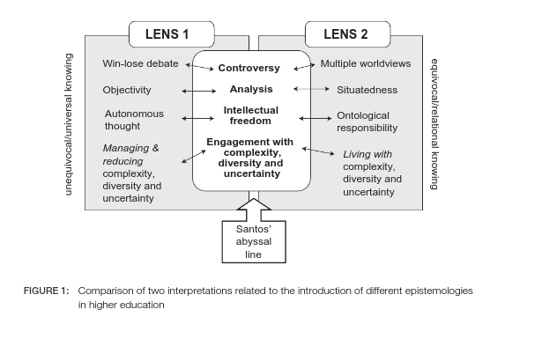
Ways of Approaching Argument
In Western education, we value unequivocal knowing - 'right' and 'wrong
In other traditions, equivocal knowing is valued - 'living with diversity and uncertainty' is part of knowing.
This is sometimes called 'two-eyed seeing' in indigenous knowledge.
In most classes, this is the type of argument that is expected; but we are starting to see ways of incorporating multiple ways of knowing into academic work.
From: De Oliveira Andreotti, Vanessa & Ahenakew, Cash & Cooper, Garrick. (2011). Epistemological Pluralism: Ethical and pedagogical challenges in higher education. AlterNative: An International Journal of Indigenous Peoples. 7. 40-50. 10.1177/117718011100700104.

