Slide 1

Compassion and emotional intelligence in academic support
James Harvey

Slide 2

EMOTIONAL INTELLIGENCE
Emotional Intelligence (EI) describes a person’s ability to identify, understand, manage, and harness their own emotions and those of the people around them.
*Constructive feedback
*Recognizing emotional states
*Remaining calm and productive under pressure
*Resolving conflict
Self-care is of the utmost importance – Always remember to take time for healthy, emotionally nourishing activities!

Slide 3
EI: The Basics
Self-awareness
Social skills
*Temet Nosce – Know thyself!
Sense the emotion
Acknowledge it
Identify facts
Accept the emotion
Reflect on why the emotion presents itself in that moment
Act: express yourself and take appropriate action, if needed
Reflect on the utility of the response and takeaways
*The Toolbox
The skills to manage emotionsLe and to connect, interact, and work with others.
*Communication
*Leadership
*Conflict Management
*Collaboration and Cooperation
*Relationship Building
Self-management
Social awareness
*The Imp of the Perverse
Also called self-regulation, the ability to manage our thoughts, feelings, and actions flexibly to achieve the desired results.
*Amygdala hijack/hyper-focus
*A Mile in Their Shoes
The ability to accurately notice the emotions of others and read social situations appropriately.
*The difference between empathy and sympathy (perspective)

Slide 4

EMPATHY vs. SYMPATHY
Dr. Brené Brown
*Social worker
*Academic
*Public speaker
SYMPATHY
EMPATHY
*Understanding another’s emotions and commiserating from our own perspective
*For example, feeling pity
*Understanding and sharing the emotions of another
*Assuming their perspective
STEPS TO SHOWING EMPATHY
Perspective taking
Listening and abstaining from judgement
Recognizing emotion in another person that you may have previously experienced
Communicating that you recognize that emotion

Slide 5



How can emotional intelligence be improved?
Recognize your emotions
Read literature
Ask for feedback
*Djikic et al. “Reading other minds: Effect of literature on empathy.” Scientific Study of Literature, Volume 3, Issue 1, January 2013, p. 28-47
Take a moment to name your feelings – not only those most active in your mind, but also underlying emotions. Be certain you are basing your actions and reactions on healthy emotions.
Studies* show that reading stories from other people’s perspectives gives us insight into their thoughts, motivations, and actions. Seeing points of difference and similarity may enhance our own self-awareness.
It is useful to seek out feedback, but also be open to constructive criticism offered by managers, colleagues, friends, or family. “Audit” your level of self-awareness with information from others.

Slide 6

COMPELLING PERSONAL ANECDOTE
Martin [Last name withheld]: general contractor, curmudgeon, unexpected humanitarian
[Hold for applause, heartfelt tears]

Slide 7

Remembering compassion

Slide 8

Mental health challenges
A growing concern
From 2007 to 2017, emergency room visits related to mental health for Canadians under 24 increased by 75 percent.
A vulnerable group
According to the Centre for Addiction and Mental Health (CAMH), persons between the ages of 15 and 24 are the most likely age group to experience mental illnesses and/or substance use disorders.

Slide 9
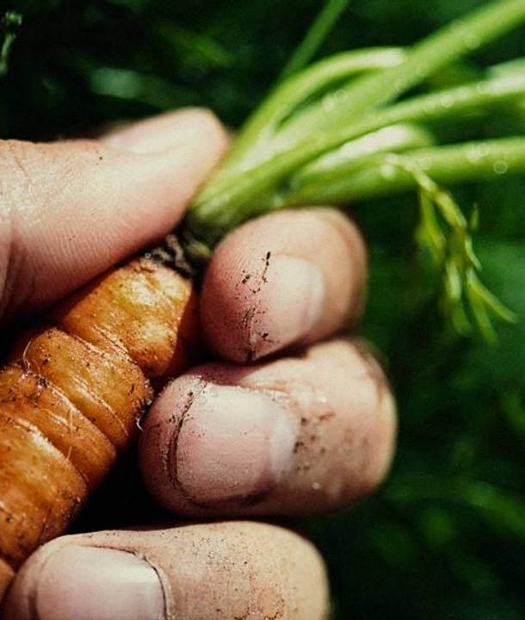
questions for the group
*What kind of challenges do university students face?
*What was your greatest challenge or obstacle in university?
*Were there appropriate supports at your university? Did you access them?
*What would have made them easier to access?

Slide 10

practical guidelines
familiarity
validation
facilitation
Be aware of the supports available to students.
Acknowledge distress and the importance of mental health.
Help connect students with available supports.

Slide 11
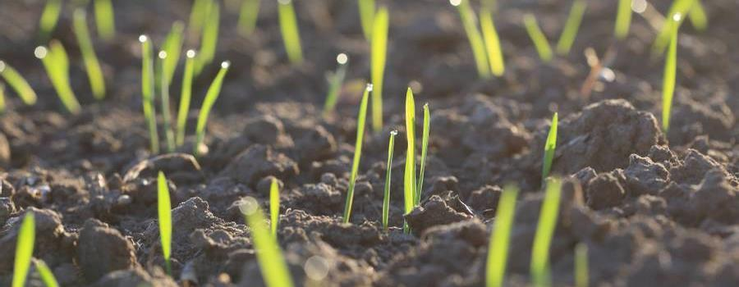
Self-care
Mental health
Physical health
*Stay connected to family and friends
*Set goals and priorities
*Practice gratitude
*Focus on positivity
*Regular exercise
*Hydration and nutrition
*Adequate sleep
*Professional medical attention
“Cross-listed” activities: Yoga, hiking/forest bathing… Or whatever works for you!

Slide 12

Things to remember
(Besides all the other things, remember them too)
*Having empathy does not mean you are responsible for the health and happiness of others.
*Do not overstep your abilities or purview – guide students to the appropriate resource, rather than trying to do everything yourself.
Boundaries are good
Point of contact
*You may be the first person a student in distress speaks to – don’t be the last!
*Being continually open and free with information about supports and fostering a compassionate environment can help reticent students feel able to ask for help

Slide 13

Thank you
“Emotional Intelligence in the Workplace”
Valamis Learning Solution
​​https://www.valamis.com/hub/emotional-intelligence-in-the-workplace
“How Do I Support Students with Compassion and Empathy?”
University of Massachusetts Amherst Center for Teaching & Learning
https://www.umass.edu/ctl/resources/how-do-i/how-do-i-support-students-compassion-and-empathy
“How to Improve Your Emotional Intelligence”
Harvard Division of Continuing Education
https://professional.dce.harvard.edu/blog/how-to-improve-your-emotional-intelligence/
Dan Harvey
(formerly owner/operator of DH Business Services)

